Slide 1
Méthodologie du travail scientifique Lecture et recherche bibliographique
Dr. Amer Draa
<numéro>

Slide 2
Recherche bibliographique
Phase 1: Exploration en largeur d’abord (environ 1 mois)
La plupart des idées fertiles naît de rencontres impromptues avec des livres ou des personnes que l’on n’avait pas prévu de consulter; sachez donc favoriser ces rencontres
Phase 2: Lecture orienté par la problématique
Discussions avec l’encadrant + définition de la problématique => Resserrer vos lectures sur ce qui touche le plus directement à votre sujet.
Phase 3: Lecture orienté par la contribution
Implémentation de la solution
Comparaisons
Benchmarks, etc,
<numéro>

Slide 3
Recherche bibliographique (2)
Toute idée non archivée est une idée perdue
Il y a donc deux façons de perdre une bonne idée : ne pas l’archiver, et l’archiver mal
Sorce cards
Note cards
Identifier chaque référence dans votre répertoire des PDFs
Pdf writers offre la possibilité d’utiliser les couleurs
<numéro>

Slide 4
Important
Le projet de recherche de master se fait à la bibliothèque et à la salle de lecture,
<numéro>

Slide 5
Lecture, quelques idées
Des sources principales aux sources secondaires
Dans un premier temps, concentrez-vous sur les sources principales
Ensuite, vous pouvez passer aux sources secondaires,
Du général au particulier:
Les sources secondaires doivent être lues en allant du général au particulier
Quel que soit le degré de spécialisation de votre sujet, il importe toujours de savoir l’inscrire dans une vision d’ensemble.
Comment choisir les sources secondaires ?
Dans un premier temps, votre directeur peut vous donner de précieux conseils bibliographiques en vous recommandant les textes centraux.
À partir de ceux-ci, vous pourrez par vous-même rayonner vers les textes plus périphériques :
Scruter les notes de bas de pages et les bibliographies pour repérer les références secondaires,
<numéro>

Slide 6
Plus généralement, à l’exception des sources primaires ou des sources secondaires les plus centrales, il ne faut généralement jamais avoir à relire un livre dans l’année du mémoire. Lisez donc chaque texte en pensant :
« c’est la dernière fois que je te lis avant la rédaction de mon mémoire ; je dois donc archiver toute information pertinente pour mon sujet ou accepter de la perdre définitivement »
<numéro>

Slide 7
Etat de l’art, revue de littérature
Dans la littérature, on trouve quasiment toujours plusieurs approches d'une même question.
Vous pouvez en tirer profit en précisant les intérêts et limites de chacune.
Elles peuvent alors constituer les sous-parties de votre revue de littérature.
Du générale au particulier
Paradigme largeur-profondeur
en présentant rapidement les différents angles d'approche reliés à la question que vous étudiez,
les différents auteurs et disciplines qui se sont penchés sur votre sujet, etc.
Une fois cela posé, vous pourrez poser votre choix d'angle d'attaque et le traiter en profondeur.
<numéro>

Slide 8
Etat de l’art, revue de littérature (2)
Élargissez vos lectures à la littérature anglo-saxonne : c'est une source plus large que la littérature francophone.
Prenez des notes électroniquement sur chaque ouvrage et chaque article que vous lisez.
Fiche de lecture.
<numéro>

Slide 9
Getting an Overview
What is it?
Getting an overview is finding a source of information that gives you a simple understanding about a topic without telling you all about it in great detail.
An overview should have some basic facts and be in clear enough language for you to understand.
It should answer the questions; "who", "what", "when" and "where", and only briefly some of the "why" and "how" questions.
Think of an overview as a picture taken from a distance where all of the details are not in focus. Your later research will bring those details into focus.
Why do it?
Getting an overview will help you get a general understanding of your topic.
begin to know what kinds of subtopics are within the general topic.
begin to ask some questions that you will answer later in the research process.
begin to focus your topic into one you can handle in your project.
<numéro>

Slide 10
Getting an Overview (2)
How do I find one?
Encyclopedias are one of the best sources of overviews. They organize information into subtopics and don't go into too much detail.
Encyclopedias are available in print and on the computer. Some articles are very long, so if you are using one on the computer, don't just print the whole article. Select the sections that you need and just print those.
Ask a library staff person for instruction if you are not familiar with using encyclopedias. You can also find some good overviews on websites, but you need to be able to evaluate the information you find to make sure it is accurate information.
It is better to use an encyclopedia first, get some basic information, and then search for a website. You can compare the website information to that in the encyclopedia to make sure it is accurate.
Short books and books written for younger readers can also be very good overview sources.
They often provide good pictures, charts, and graphs, as well as time lines and glossaries to aid your introductory understanding of a topic.
Since they are written for younger readers they can be read quickly and provide a good foundation for understanding books and articles written for high school and adult readers.
<numéro>

Slide 11
Getting an Overview (3)
What do I look for in an overview?
Notice the way the information has been organized within the overview.
Take notes on the headings and subheadings that are used to subdivide the information.
These can give you some possible ways to help focus the topic of your paper.
In a short book, look at the table of contents for subtopics.
Select a subtopic that interests you from the overview.
Once you have an understanding of the general subject and a particular subtopic, narrow your topic down more.
<numéro>

Slide 12
Making a List of Possible Sources
Once you have an overview of your topic,
First think about what kinds of information you need.
Do you need quotations, maps, diary entries, political cartoons, song lyrics, diagrams, narratives, statistics?
Once you know the kinds of information you need, you can make a list of all the possible sources in which you think you can find that information
These could include any of the following, or others:
Books
Journal Articles
Newspaper Articles
Maps or Atlases
Expert people
Site visits (to museums, etc.)
Television Shows
Radio Shows
Sound Recordings
Video Recordings
Electronic Databases
Websites
<numéro>

Slide 13
Getting and exploring the list of sources
Now star the sources on your list that you will most likely be able to use, given the time and sources you have available.
Give them a prioritized number order for which you will use first, which second... etc...
Once you do this, you are ready to start locating these sources.
Hint: Librarians (Supervisors, colleagues, etc,) are very useful at knowing which kinds of sources can be used to find certain types of information. Use their expertise. It will save you valuable time.
<numéro>

Slide 14
Finding Information Within Sources
Being able to put your hands on the information you need from many different types of sources.
If you don't know how, you will waste a lot of time looking through sources for the information you need.
In order to find the information you need within a source, you have to be able to use different types of organizing tools.
The most common tools are:
tables of contents
indexes
in electronic databases, you can use search boxes.
search engines.
<numéro>

Slide 15
Source Cards
What are they?
They are index cards (you can also use notebook pages, a word processing document or database document) on which you put all of the information you will need about all the sources you use.
Why will I need them?
They will help you to:
identify the sources of quotations and ideas for citing your sources later (giving credit to your sources).
find sources again if you need them.
make your works cited (a list of the sources from which you used borrowed material in your project).
<numéro>

Slide 16
Source Cards 2
How to do it:
Use index cards to make your source cards, or keep a few notebook pages reserved for this information, or make a word processing or database file for them. If you use index cards, use only one card per source.
Code each source its own number, starting with the number 1. You will later link your notes to these code numbers.
There are many, many different types of sources: books, websites, videos, tv shows, people, to name a few.
<numéro>

Slide 17
Use of Information
What information does the source give me?
Is the information in-depth enough for me? Or is it too superficial (simple)?
Does the information give you answers to your questions?Does the information give you new ideas, or lead you to other sources?
Is the information given in the types of formats you need (maps, dates, graphics, etc.)?
Can I understand the information?
Is it in a language you can understand?
Is it too scientific or technical?
Does it use too much specialized language that you don't understand?
If the language is not right for you, look for the same information in other sources. If you cannot find any, ask a librarian to help you. There is always information available for both experts and non- experts in most topics.
<numéro>

Slide 18
Use of Information (2)
What information can I use?
This is a good time to go back and recheck your task, your specific assignment. Then compare your assignment against the information you have found. Answer the following questions:
Does the information included in the source help me complete my task?
If it does, then you will be able to start "extracting" the information.
If it does not, you will need to look for information in other sources.
Does the information in the source give me additional ideas that make me want to change my original thesis?
If you find that there is too much information on your topic, you may want to narrow down your topic,
If you are not finding enough material on your topic, you will want to go through the same process to broaden your topic (make it larger to include more material).
<numéro>

Slide 19
Use of Information (2)
How will I get the information out of the source?
There are a number of ways to extract information out of a source, depending on the type of source and the equipment available to you.
Note-taking
Photocopying
Printing (from a computer source)
Videotaping
Tape recording
Interviewing (and note taking or tape-recording)
Photographing
Scanning
Drawing or sketching
<numéro>

Slide 20
Plagiarism !!!
Warning!! You must give credit to the source of any information you use directly or paraphrase. This is called citing your sources.
If you use in your final product any data, sentences, paragraphs, sounds, or images (pictures) without citing the source, you are committing an unlawful act called plagiarism, which means pretending someone else's work is your own.
There are legal consequences for doing this. That is why it is very important to give credit to any material you use that is not originally your own. The best time to do this is when you are taking notes or copying information in any way,
Make Source Cards for all sources you use. Identify on your notecard the source for any information you print out or copy from a computer source, photocopy from anything, scan electronically, or directly copy into your notes.
<numéro>

Slide 21
Use of Information (3)
Does the information give me any other key words or phrases that I can use to lead me to other information?
This is a good opportunity to get "leads" to more information.
Look up any names, places, or any other terms that you think will help explain your subject or support your argument better.
Am I ready to start putting a draft of my project together?
Have you double-checked factual information in a couple of sources?
Have you collected all of the kinds of information you need (these may include any pictures, maps, data, etc.)?
Have you recorded the bibliographic information for any sources you used?
Do you have enough information to begin organizing it?
At this point it is best to make an outline to create a structure for your project.
Now you can see if you are missing any information, want to eliminate any information, or need to change your thesis or topic in any way.
<numéro>

Slide 22
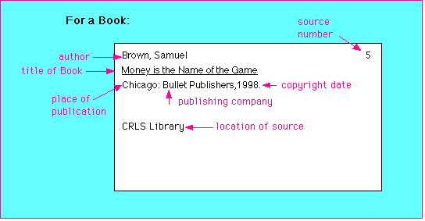
Sample Source Cards (1)
<numéro>

Slide 23
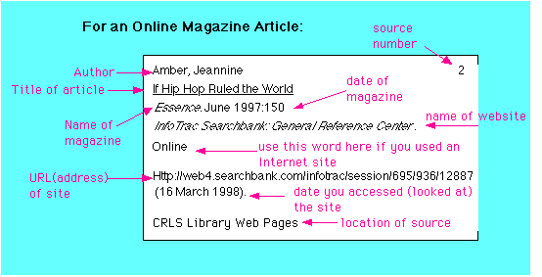
Sample Source Cards (2)
<numéro>

Slide 24
Making Note Cards
It is useful to take notes on index cards
it gives you the flexibility to change the order of your notes and group them together easily.
How do I do it?
1 . Write the subtopic heading of the note at the top of each note card.
2. Write only one main point on a note card
3. Only write information directly related to your Statement of Purpose.
4. Write only essential words, abbreviate when possible.
5. Be accurate: double check direct quotes and statistics.
6. Identify direct quotes with quotation marks and the person's name.
7. Bracket your own words [ ] when you add them into a quote.
8. Use ellipsis points (...) where you leave out non-essential words from a quote.
9. Distinguish between 'fact' and 'opinion'.
10. Include the source's number on the card
11. Write the page number of the source after the note.
12. Use the word 'over' to indicate information on the back of the card.
<numéro>

Slide 25
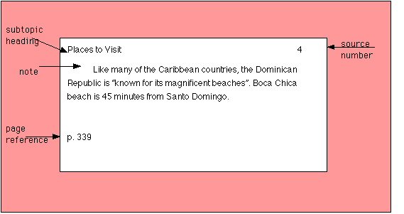
Making Note Cards (2)
<numéro>

